Slide 1
Monopoly.java
By Aditya Kotak, Rahul Sarathy, William Wang

Slide 2
Outline
Explain the traditional Monopoly game
Explain concerns for how to translate that to java
Explain how we converted it into Java
Other considerations needed in the program
How we implemented those considerations
Data Structures used
Testing, Debugging, and Changes
Demo
Notes:
Aditya

Slide 3
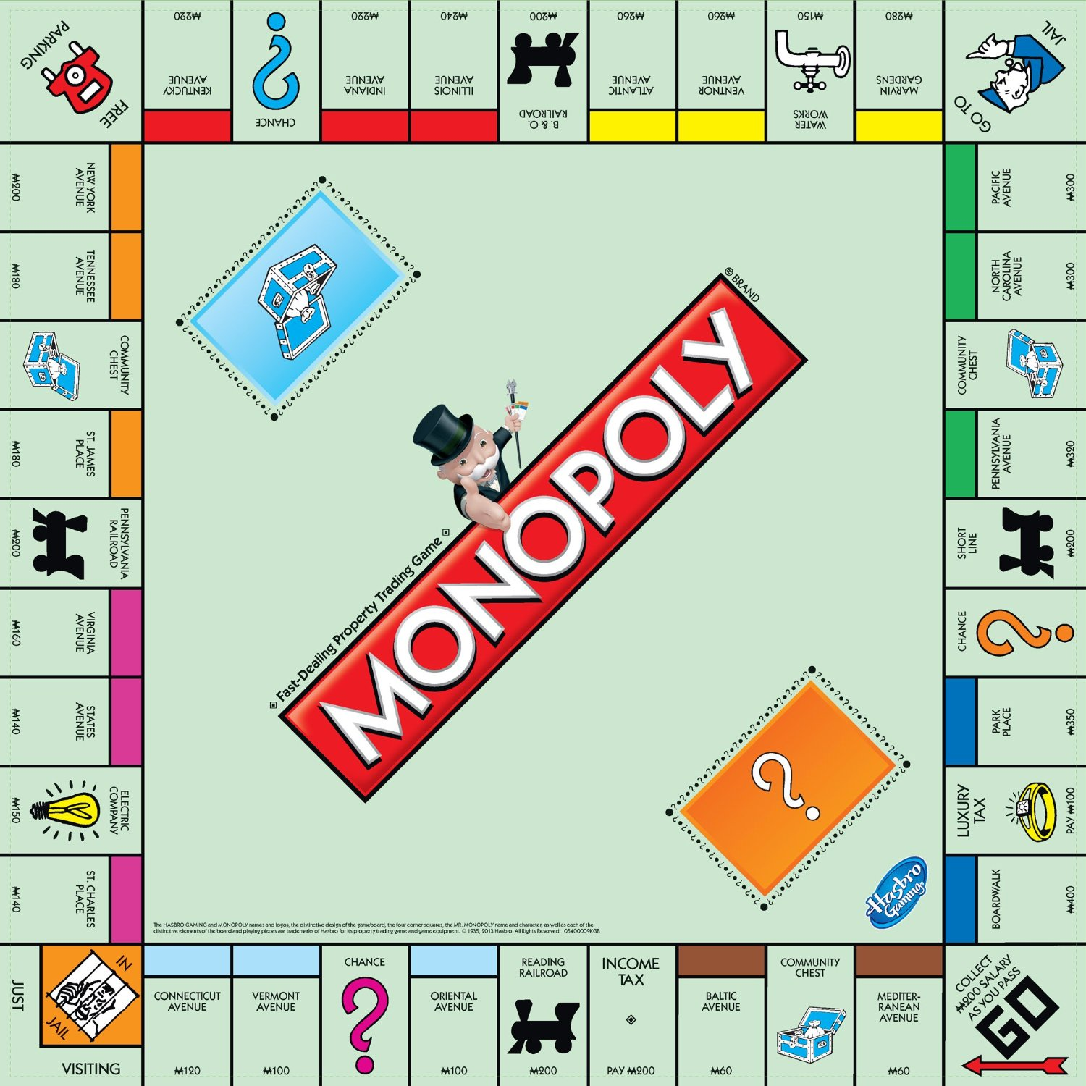
Welcome to Monopoly!
What is Monopoly?
A business game where players attempt to make their opponents bankrupt by purchasing properties/railroads/utilities and buildings.
Buildings are based on groups of properties
If you land on an owned space, you pay rent (Extra rent if the space has been improved)
You can go to jail and pay a fine to get freed
Notes:
Aditya

Slide 4
What we had to do
We had to start off by creating numerous objects
Player
Space
PropertySpace
RailroadSpace
UtilitySpace
TaxSpace
FreeSpace
GoSpace
GoToJailSpace
JailSpace
CC/Chance Space
Card
Community Chest
Chance
Houses
An object to play the game
An object to be used to form the various spaces on the board
An object to represent the properties on the board
An object to represents the railroads on the board
An object to represent the utilities on the board
An object to represent the tax spaces on the board
An object to represent free parking
An object to represent the Go Space
An object to represent the Go To Jail Space
An object to represent Jail
An object to represent CC/Chance spaces
An object to help create the CC/Chance card
An object to represent community chest cards
An object to represent chance cards
An object to represent the buildings (houses and hotels)
Notes:
Aditya

Slide 5
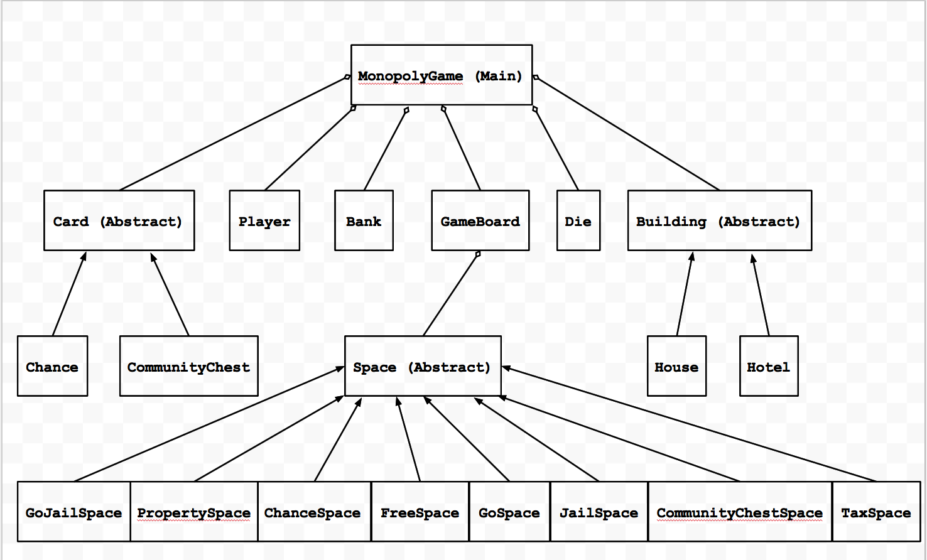
Notes:
Rahul

Slide 6
What we had to do (cont)
Adhere to the myriad rules of Monopoly
Only buy houses on properties that have an entire group owned by one player
Only buy hotels once all properties on a group have 4 houses
3 Double rolls in a row means sent to jail
Being sent to jail means you don’t get to collect $200 for passing Go
Deal with bogus responses to prompts
Activate certain options once criteria has been met
Get out of Jail Free card can only be used if you have a get out of jail free card
Can only buy houses if you own an entire property
Notes:
Rahul

Slide 7
What does this mean?
Thank goodness for Object Oriented Programming!
We had ~22 classes in order to complete our project.
In most cases, each class created a specific object and implemented its’ methods.
All had to work in conjunction to function
Notes:
Aditya

Slide 8
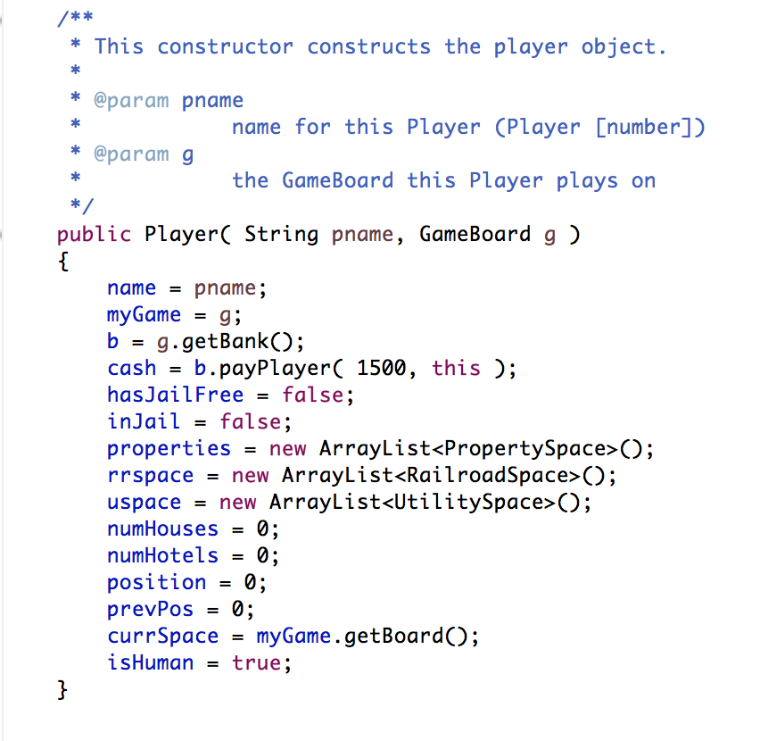
Player.java
This object needs to play the game.
Buy properties, houses, hotels, payBank, move etc.
Notes:
William

Slide 9
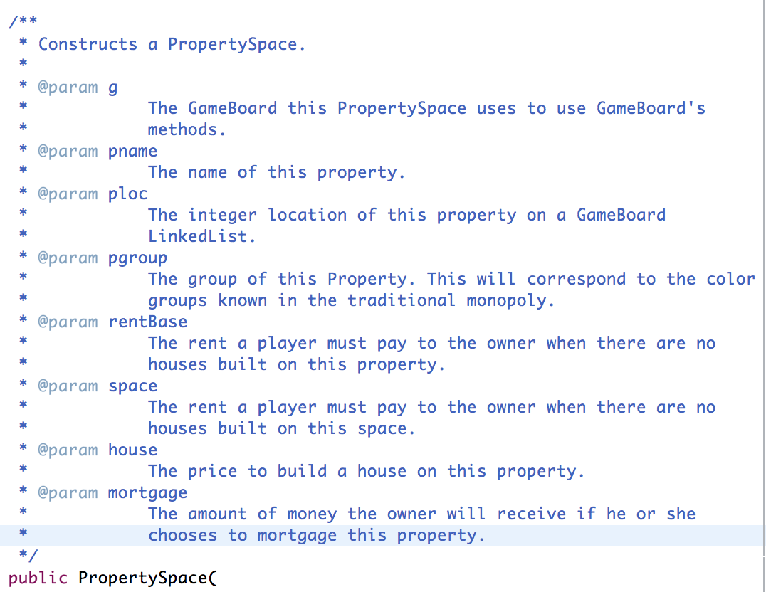
PropertySpace.java
Represents a PropertySpace
Should be buyable.
Must keep track of houses/hotels
Notes:
Aditya

Slide 10
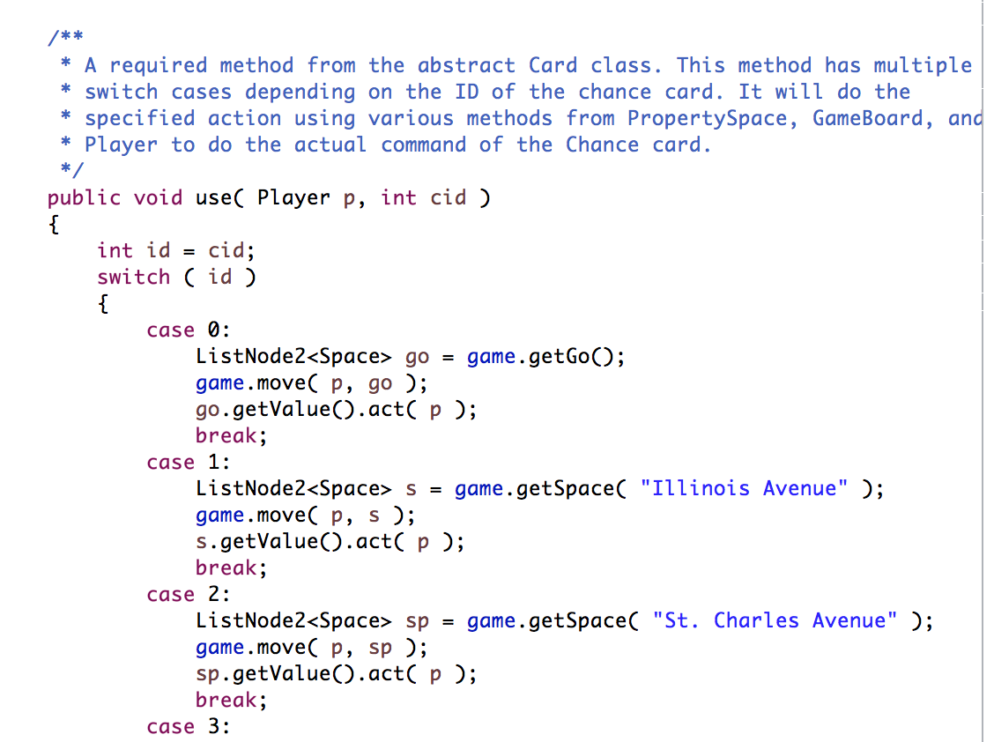
Chance.java
Randomly choose a card from a and implements its command.
Needed to use switch cases to cover all possibilities.
Notes:
William

Slide 11
Jail.java
Had to block the player from moving if in Jail
Allowed three options to get out
Roll doubles
Pay out
Get out of Jail Free Card
Go To Jail Space worked in conjunction with this
Notes:
William

Slide 12
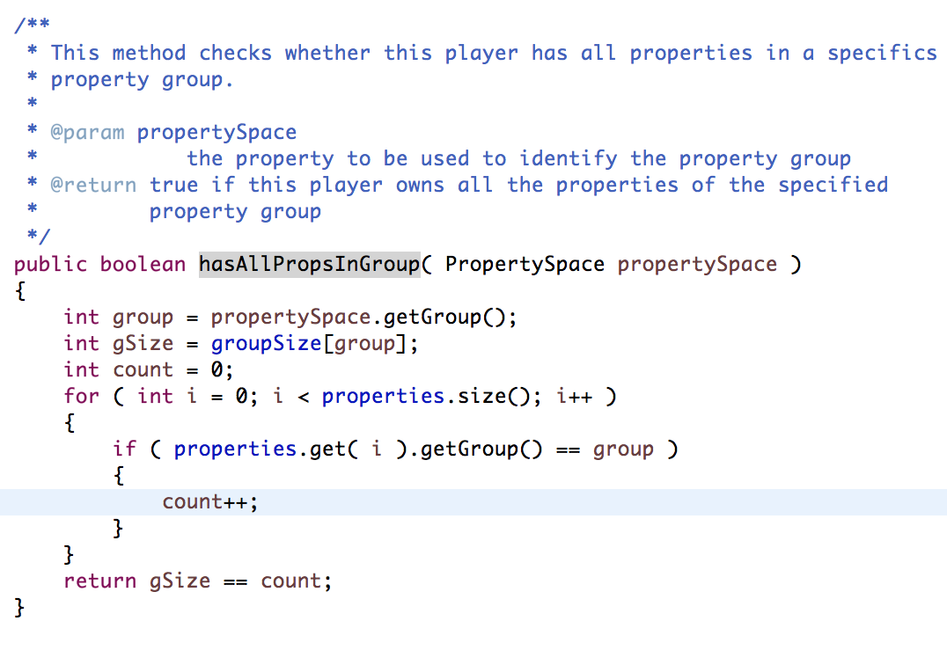
Algorithm for Checking Property Block
Part of Player class
We need to use the Property Space Object
Helps to check if properties can be bought
Notes:
Rahul

Slide 13
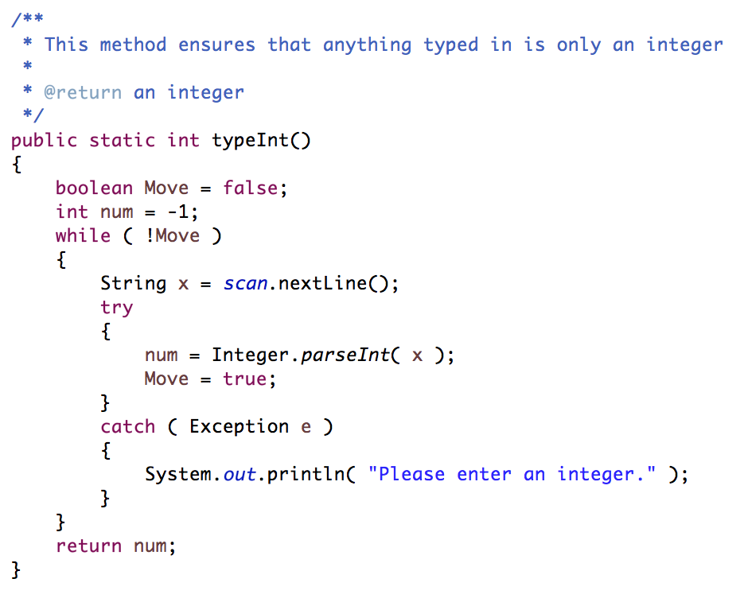
Algorithm for checking bogus input
Makes sure only and integer is inputted by the user.
Uses a try catch exception handling as to not crash
Used whenever the player need to make a decision
Notes:
Aditya

Slide 14
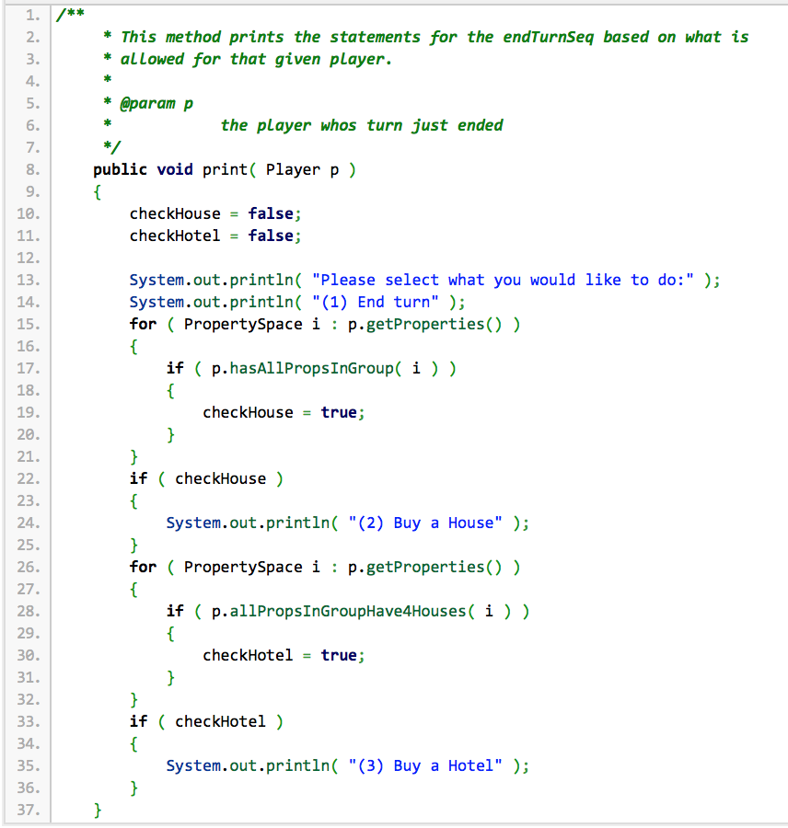
Algorithm for specific activation
At the end of each turn, a series of choices is presented to the user
The choices are based on what the player is allowed to do.
Notes:
Rahul

Slide 15
What else we had to code
Other considerations to complete the game
Creating the board
“Mortgaging” buildings/properties
Creating a bank to handle transactions
Making sure the card’s commands were implemented correctly.
Making an AI
Notes:
Rahul

Slide 16
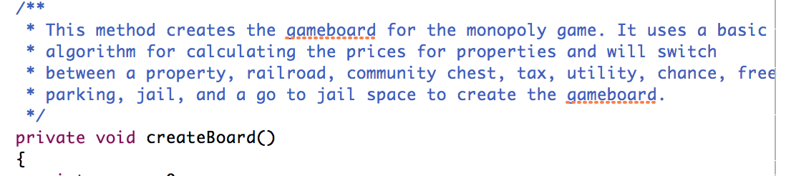
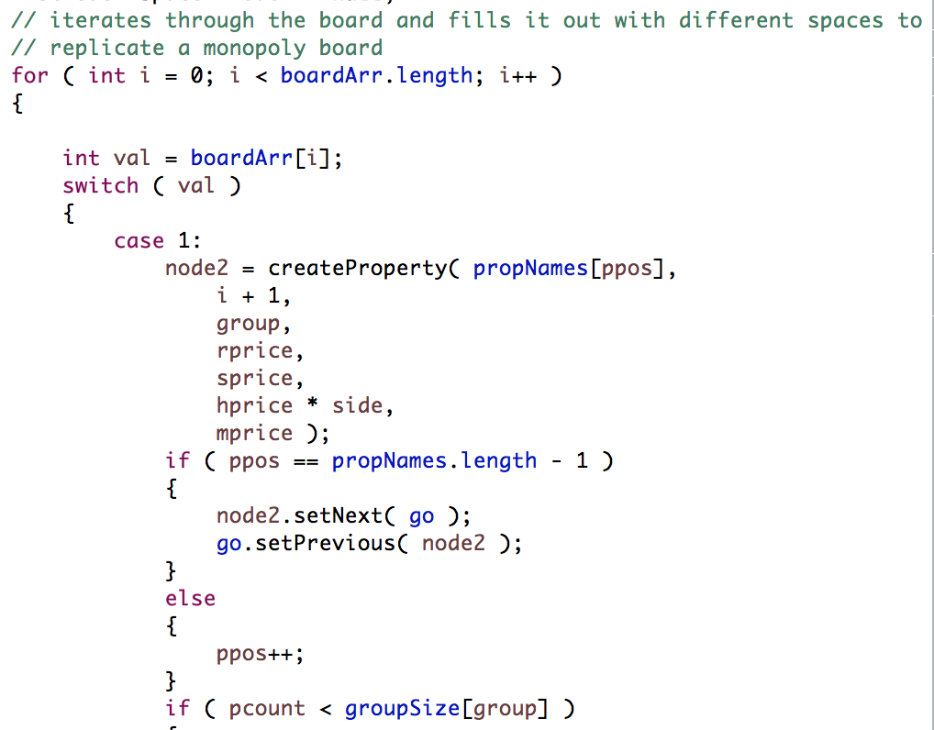
Creating a Board
One iteration through the size of the board with multiple switch cases
Notes:
William

Slide 17
Mortgaging
Had to automate “Mortgaging” for simplicity.
Elongated the gameplay but more traditional.
Selling only happens once you reach negative money.
Hotels → Houses → Utilities → Railroads Properties → Bankruptcy
Notes:
Aditya

Slide 18
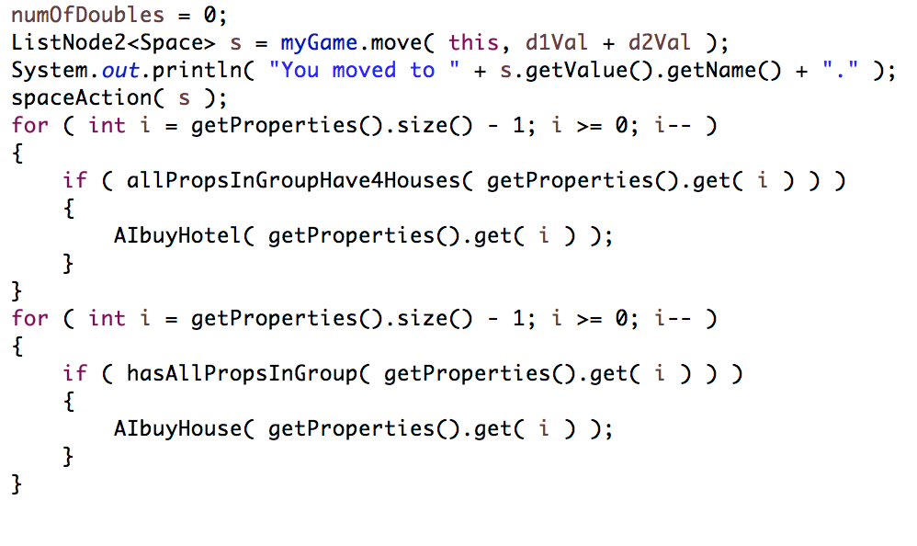
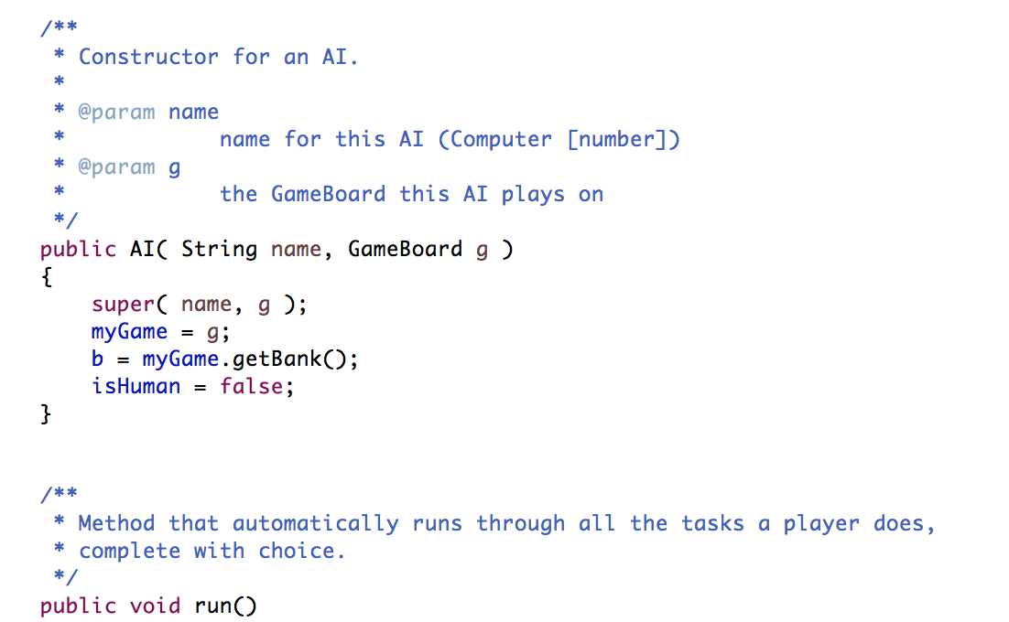
The AI
Buy until no more money.
Always try card then spend $50 to get out of jail
Buy houses as many times as possible (25% of money reserved)
Notes:
William

Slide 19
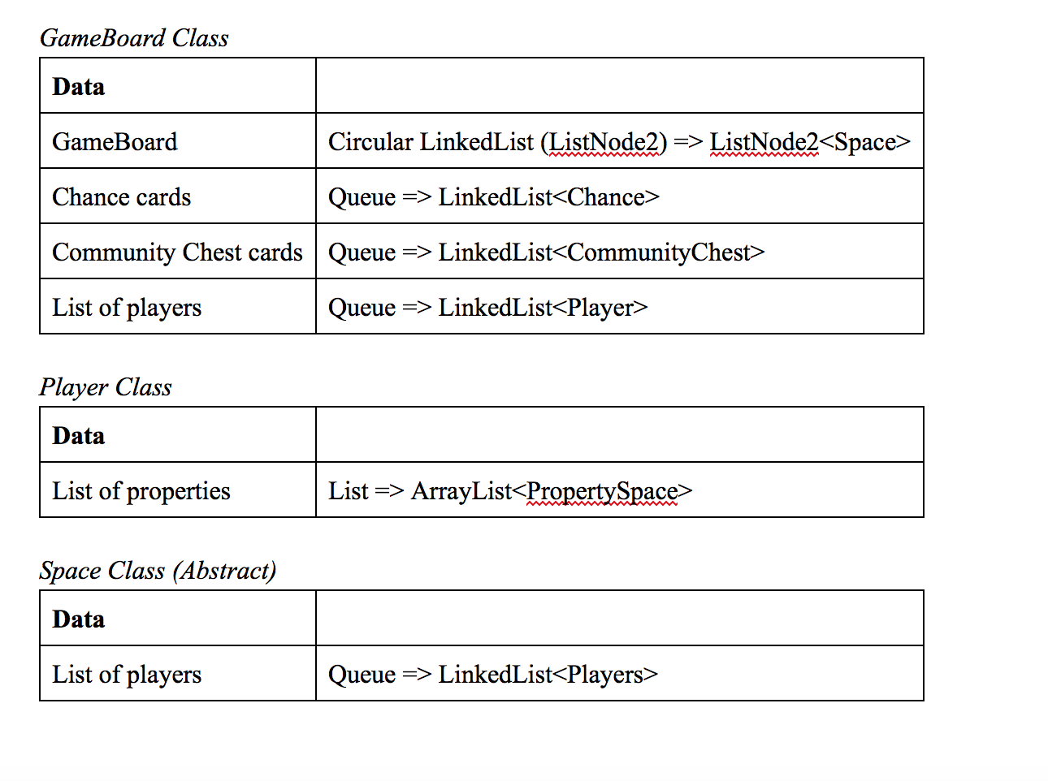
Data Structures Used

Slide 20
Testing and Debugging (+ changes)
We created JUnit test to make sure our code was on track with what we intended.
Debugging: We ran simulations with 2 AI’s.
Changes: Mortgaging was automated
Notes:
Rahul

Slide 21
Demo!
Notes:
William

